Slide 1
API Connect Fundamentals
Ozair Sheikh
Senior Offering Manager – API Connect & Gateways

Slide 2
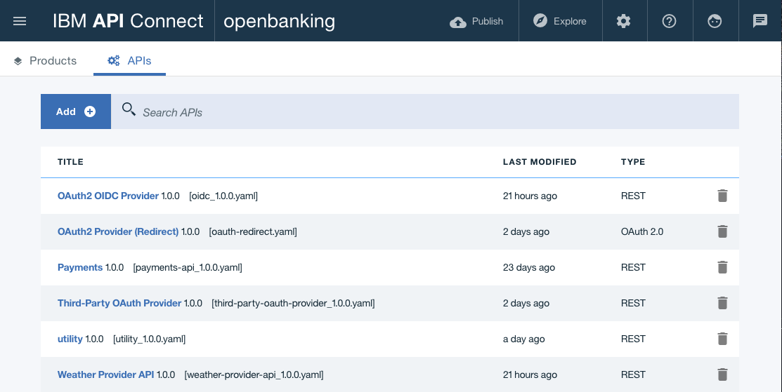
What is the API designer?
API Designer is a graphical user interface within the API Connect developer toolkit
Provides functions for the creation and configuration of API definitions, running `offline` (on developer workstation).
Drafts mode in API Connect also embeds the API designer but is considered the `online` mode.

Slide 3
API Connect command line: apic
The command-line apic is the entry point for the API designer.
Directory where command is issued from becomes your ‘workspace’
Includes yaml files and and project-specific metadata
$ apic edit –help
Usage: apic edit DIRECTORY
Open the API Designer
Options
DIRECTORY directory to open API Designer in (optional)
Open the API Designer
$ apic edit
Open the API Designer in a LoopBack application directory
$ apic loopback --name climbon_application
$ apic edit climbon_application

Slide 4


DataPower Integration with API Connect Developer Toolkit
Develop and test all API security, traffic management and mediation policies on laptop with built-in DataPower support in Developer Toolkit for increased developer efficiency
Embeds and utilizes free Docker-based DataPower Gateway for dev and unit testing
Live update support, i.e. no need to restart the Gateway for policy updates
Integrated DataPower and Toolkit logging for quick problem identification
Easily publish APIs to on-premises or cloud API Connect deployment after testing
https://www.npmjs.com/package/apiconnect

Slide 5

Running DataPower Gateway on Docker in Developer Toolkit
Prerequisites:
Docker for Mac or Windows and recommend atleast 4GB CPU & 4GB RAM
Start DataPower Gateway on Docker with the following options
API designer toolkit (press play at the bottom of page)
Command line (apic services and use (apic services) to view status of containers
$ apic services:start
Service openbanking-gw started on port 4001
$ docker ps
CONTAINER ID IMAGE COMMAND CREATED STATUS PORTS NAMES
95034130719f ibm-apiconnect-toolkit/datapower-api-gateway:1.0.10 "/bin/drouter" 7 days ago Up 4 days 0.0.0.0:32771->80/tcp, 0.0.0.0:32770->5554/tcp, 0.0.0.0:32769->9090/tcp, 0.0.0.0:4001->9443/tcp openbanking_datapower-api-gateway_1
3710912a5540 ibm-apiconnect-toolkit/datapower-mgmt-server-lite:1.0.10 "node lib/server.js" 7 days ago Up 4 days 0.0.0.0:32768->2443/tcp openbanking_datapower-mgmt-server-lite_1

Slide 6
API Assembly Overview

Slide 7

API Assembly: Visual flow editor to enrich real-time messages
Drag and drop policies onto canvas to create an assembly to process incoming requests
E.g. auth/auth, flow control, invoke, etc.
Pallette of operations (aka policies)

Slide 8
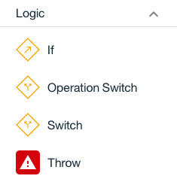
Conditional Flows
Apply logic constructs to the API assembly to conditionally control the flow of data through the API assembly either before or after API invocation
If: execute a set of policies based on the fulfillment of the condition
Operation-switch: execute a set of policies based on the API operation
Switch: multiple case statements that allow you to execute a set of policies based on the condition
Throw: throw an error when reached during execution of API assembly

Slide 9
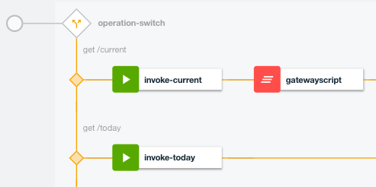
Sample Conditional Policy
The operation-switch allows conditional execution based on the runtime API operation
The get /current API operation executes invoke-current and gatewayscript
The get /today API operation executes invoke-today

Slide 10

GatewayScript™ - secure & optimized JavaScript runtime
JavaScript-based gateway runtime which simplifies configuration for developers and provides an easier development paradigm for Mobile, Web, & API
Performance
Compiler technology & native execution
Built on intellectual capital and expertise from 10+ years securing and optimizing XSLT parsing/compiler technology
Security
Transaction isolation
Code injection protection

Slide 11
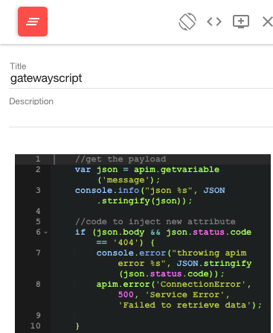
GatewayScript for API Connect
Use GatewayScript to manipulate headers, payload or perform off-box calls using url-open.
Code is similar to running on standalone DataPower Gateway with a few exceptions
Use apim module to get/set variables
var json = apim.getvariable('message');
apim.setvariable('message.body', json.body);
Use apim module to read input payload
apim.readInputAsJSON(function (error, json)
Use apim module to read runtime context variables
apim.getContext('request.parameters.component')

Slide 12
Common GatewayScript code snippets
GatewayScript modules are available within GatewayScript assembly policy (URL, service-metadata, header-metadata, urlopen, querystring, & util)
Common GatewayScript functions
Trigger an error (similar to throw)
apim.error('MyError', 500, 'Internal Error', 'Some error message');
Write the final results to the session
session.output.write('{ "status": "created" }');
Set message headers
apim.setvariable('message.status.code', 401);
Notes:
See https://www.ibm.com/support/knowledgecenter/SSMNED_5.0.0/com.ibm.apic.toolkit.doc/rapim_gwscript_codesnip.html

Slide 13
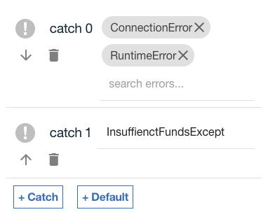
Handling API Errors
Errors can range from built-in (ie connection failure) or custom (ie Errors can range from built-in (ie connection failure) or custom (ie InsuffienctFundsException).
Multiple approaches are available to throw errors:
Throw policy that triggers the global error handler into the catch space, which can contain policies to return an error message to the client.
Throw errors in your GatewayScript code when an error condition is reached.
Example: Invoke policy returns an non-200 error.

Slide 14
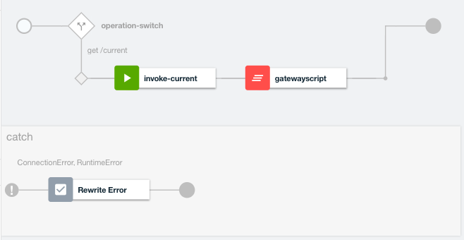
Global error handler in API Assembly
The API assembly provides a single global error handle to catch errors thrown by any policy.

Slide 15

JSON security
Provide enhanced message-level security for mobile, API, and web workloads
JSON Web Encryption for message confidentiality
JSON Signature for message integrity
JSON Web Token to assert security assertions for Single Sign On (SSO).
JSON Web Key (JWK) to represent cryptographic key
Provides end-to-end security between Mobile application and System of Record applications
Secure sensitive data (credit card data) between multiple untrusted or unmanaged systems without compromising the data to help support PCI compliance

Slide 16
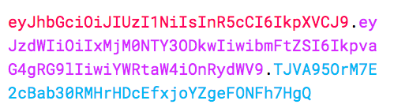
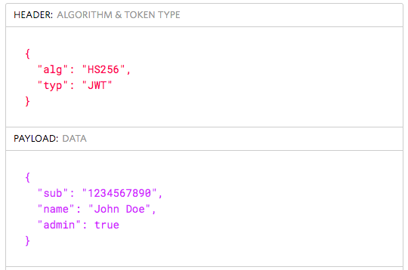
What is a JSON Web Token (JWT)
JSON Web Token (JWT) is a compact, URL-safe way of representing claims that are to be transferred between two parties.
Transmitted via HTTP header (default) or payload
Scenarios
Authentication: assert user login information within JWT so that subsequent logins will use JWT for SSO
Information Exchange: asserting identity information securely between two parties
JWT consists of three parts (separated by dots)
header.payload.signature (xxxxx.yyyyy.zzzzz)
Notes:
Based on industry standard RFC 7519

Slide 17
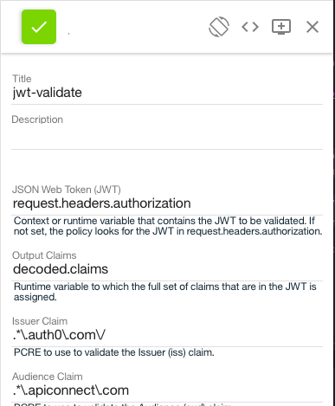
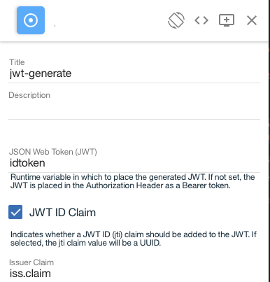
Generate and validate JWT Tokens
Two policies available for generating and validating JWT tokens
jwt-validate: enables you to secure access to your APIs by using JWT validation.
Extracts the token, verifies, and decrypts (if appropriate) the signature, and validates the claim.
If valid, the claim is put in a runtime variable (for subsequent use if required), and access is allowed to the API. If the claim is not valid, access is denied.
jwt-generate: generate claims that are asserted by API connect and target for specific recipients.
Optionally sign JWT (JSON Web Signature (JWS)) or encrypt (JSON Web Encryption (JWE)) using JWK (JSON Web Key) or PKI key material (RSA algorithms).

Slide 18
Secure API resources using OAuth & OpenID Connect

Slide 19
OAuth Overview
Allow you to share your resources with a third party application without sharing your credentials with the third party application
Highly secure access token – signed and encrypted using a shared secret
Secure token exchange without compromising user credentials
Lightweight format compared to SAML and other secure token formats
Popular token format for Mobile applications that provide longer login sessions

Slide 20


API security
API Gateway Capabilities
Authorization Server: validates resource owner credentials using Form-based Web authentication or HTTP Basic Auth. Flexible authentication of OAuth client credentials using SSL or JWT token
Resource server: validate access token (via DataPower or third-party Authorization server) and enforce additional policies for security, integration and quota enforcement.
Token management: manage revoked tokens from resource owner or client application
Customizable OAuth flow with GatewayScript/XSLT extensions to meet enterprise requirements
User
(resource owner)
Authorization Server
Access control / Token mgmt
Runtime
OAuth Application
Runtime
(Mobile / Web app)
Resource Server
Protects
Resource
Runtime

Slide 21
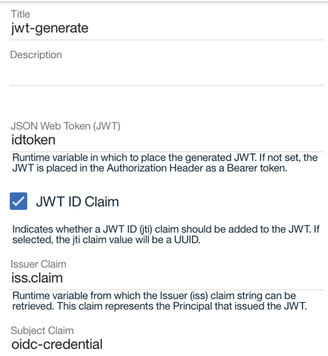
OpenID Connect Overview
OpenID Connect (OIDC): Flexible user authentication for Single Sign-On (SSO) to Web, mobile and API workloads
Provide identity as-a-service for authentication users (OpenID Connect provider)
Built on top of OAuth 2.0, for identity providers to validate, assert user identities for Single Sign-On to web, mobile, and APIs,
Address EU PSD2 and OpenBanking requirements for authorization and authentication by leveraging OpenID Connect specification
Click on this blog link to learn more

Slide 22
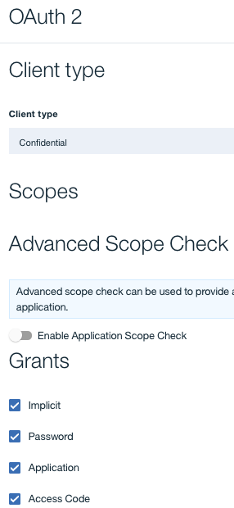
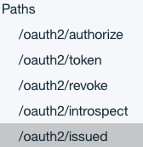
Enforce access to API resources using OAuth
An OAuth provider API can serve multiple APIs that are using OAuth security definitions.
OAuth Provider provides options:
Grants supported (implicit, password, application, and access code)
Refresh tokens, Token Time to live (ttl)
Token revocation and introspection
Provides operations that are the authorization and token endpoints of an OAuth flow.

Slide 23
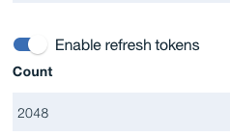
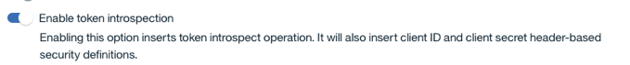
OAuth Token Management & Lifecycle
Refresh tokens allow OAuth application to obtain a new access token when existing access tokens expire without performing complete OAuth handshake again
Introspection allows the OAuth application providers to obtain details about the access token

Slide 24
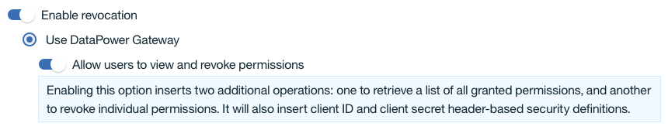
OAuth Token Revocation
Prevent unauthorized usage of APIs when permissions are compromised
Revoke specific OAuth access token (and hence applications accessing your APIs) via enhanced token management
Revoke All OAuth tokens for applications that have access to the APIs

Slide 25
Control user permissions with scopes
OAuth scope:
Resources within an OAuth flow that are shared with applications
Contract between the owner of the resource and OAuth server
Scope Check:
OAuth server issues access token with scopes based on user / application to enforce stronger & flexible resource control at multiple levels:
1. Call API with API scopes
Savings
today-soup
2. Perform Scope Check
Premium-Savings
tomato-soup
3. Validate and return new scope
Notes:
https://www.ibm.com/support/knowledgecenter/SSMNED_5.0.0/com.ibm.apic.toolkit.doc/con_oauth_scope.html

Slide 26
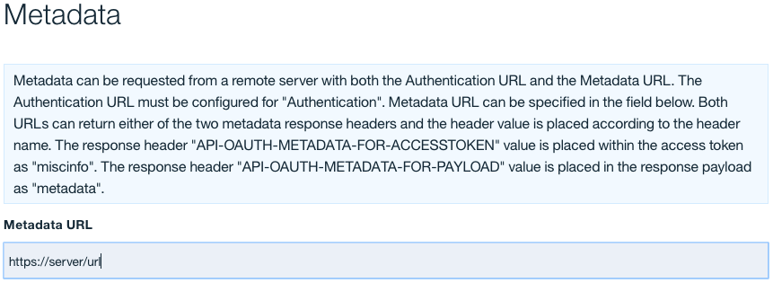
Include custom metadata within OAuth access token or payload
In many scenarios, custom metadata needs to be included during the access token generation process.
Metadata is either stored inside the access token or it is sent along with the access token to the client application.
Client application can then send that access token, or the metadata in the payload
Examples: metadata about the resource owner, grant type, or confirmation code
Notes:
https://www.ibm.com/support/knowledgecenter/SSMNED_5.0.0/com.ibm.apic.toolkit.doc/con_metadata.html

Slide 27
Third-Party Integration of OAuth & Authentication service providers

Slide 28



API Connect OAuth Provider
Authorization server: validates resource owner credentials and generates authorization code and access token
Resource server: protects backend API via an access token
Authorization
Server
User Registry
Authentication/Authorization
API Implementation
ISAM
Resource
Server

Slide 29

API Connect OAuth Provider (third-party)
Authorization server: Third-party OAuth server validates resource owner credentials and generates authorization code and access token
Resource server: Enforces access to API by validating third-party access token or cryptographically validating token
(Third Party) Authorization
Server
Registry
Authentication/Authorization
API Implementation
ISAM
Validate Token *
Resource Server
* Only needed if token is not crypto validated

Slide 30
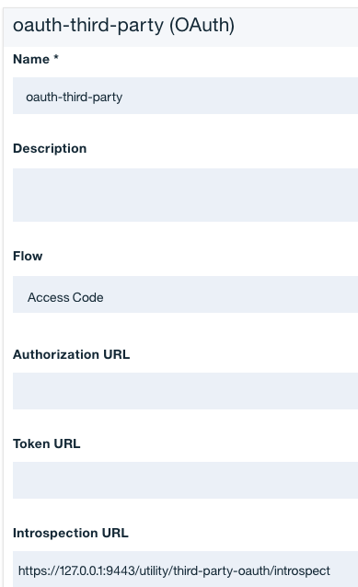
API Connect – Third Party OAuth Support
(Third Party) Authorization server: API Connect does not play any role (optionally proxy request)
Resource server: enforce API access using access tokens generated by third party OAuth providers via Introspection endpoint (Consumer API definition)
Validate token from third-party OAuth provider
Dev Portal: event hooks when new applications created within dev portal to synchronize client id, client secret & redirect URI to external OAuth server (requires custom implementation to integrate with third-party OAuth server)

Slide 31
Dev Portal – sync client credentials
Dev portal provides rules engine or drupal modules to capture app credential events (creating / update / deleting ) client id, client secret & redirect URI.
IBM provides sample Drupal plugin - need to enhance to integrate with third-party OAuth server
case "/app/create”
case "/app/update”
case "/app/delete”
case "/app/creds/create”
case "/app/creds/update”
case "/app/creds/delete”
case "/app/creds/clientid/reset”
case "/app/creds/clientsecret/reset"

Slide 32

API Connect: End-to-End Flow
Developer Portal
How App Developers find, subscribe, analyze APIs
subscribe
App Developer
1
Sync App creds (ie clientid)
2
develop
Obtains Access Token
3
Token
Validation
OAuth Server (Third Party )
Authentication
Authorization
Token management
5
develop
Application User
use
Application
4
API Gateway
API Enforcement
Traffic Management
Mediation
Target Endpoint
The “brains” of the API or Microservice, performs the business logic.

Slide 33
Third Party OAuth Support - Sequence Diagram

Slide 34
API Connect OAuth Provider using third-party Authentication service (ie redirect)
Authorization server: authentication / authorization of resource owner is performed using third-party authentication service
Generates authorization code and access token after successful authentication / authorization
Resource server: protects backend API via an access token
Third-Party
Authentication Service
Authorization
Server
Authentication/
Authorization
ISAM
API Implementation
Resource
Server
Notes:
https://www.ibm.com/support/knowledgecenter/SSMNED_5.0.0/com.ibm.apic.toolkit.doc/task_apionprem_redirect_form_.html

Slide 35
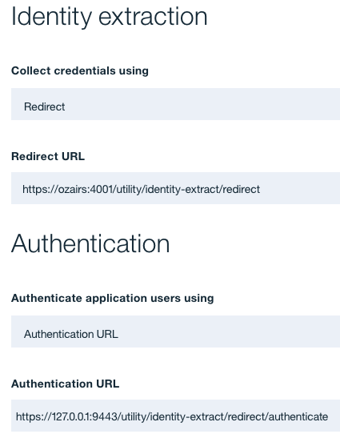
Third-party authentication service
Redirect the user agent (ie Web browser) to an externally hosted authentication service.
Example: If the OAuth endpoint is https:<api-connect-endpoint>\oauth2\authorize in the Web browser, after the redirect, it will become https:<third-party-auth-service>\login.html
The identity extraction, authentication and authorization will occur outside of API Connect.
After the authentication service has successfully authenticated / authorized the user, it will need to callback into API Connect.
`callback` is a contract between API Connect and the third-party authentication service.

Slide 36
Third-party authentication service ‘contract’
API Connect will perform a redirect to the third-party authentication service (redirect url) and populate the URL with the following info:
original-url, app, org, catalog and provider id and name
After successful authentication/authorization, third-party authentication service will need to issue a HTTP 302 request with the `Location` header containing the following:
origUrl + '&username=' + username + '&confirmation=' + confirmationCode
API Connect will extract the confirmation code from the callback URL and validate the confirmation code against the third-party authentication service validation endpoint (authentication url).
As long as the endpoint responds back with an HTTP response code of 200, then the code is deemed valid.
Notes:
original-url
* app-name
* appid
* org
* orgid
* catalog
* catalogid
* provider
* providerid

Slide 37
Third Party Authentication Service - Sequence Diagram

Slide 38
Questions

